Slide 1
The Trinity Who is Jesus the Christ? Who is the Holy Spirit?
Second Ecumenical Council

Slide 2
What is a Orthodoxy?
Ortho = Right
Doxy = praise
To praise God in the right way.
This means that we need to understand who God is and to praise Him as who really is

Slide 3
Heresy
Comes from the word αἵρεσις, hairesis
From αιρεομαι, haireomai, "choose“
It is a choice to believe in something different, or to choose half truth

Slide 4
Why important to defend the faith against the heresies?
How can you praise God in the right way if you do not believe in Him in the right way?

Slide 5
Devil’s plan
Attack the Church from the outside (persecution)
If above fails, attack from the inside.
The devil knows the Bible word for word (Math 4)
He attended more sermons that any of us
He is very smart and very clever

Slide 6
Who is God
One Substance (essence) (Ousia)
Three Hypostasis (persons)
Father
is
Is not
Is not
God’s Essence
is
is
Holy Spirit
Son
Is not

Slide 7
Examples of the trinity
Human being
Body
Soul
Spirit
John ate cheese (who ate the body, soul, spirit?)
John is angry (who is angry body, soul, spirit?)
John is arrogant (who is arrogant body, soul, spirit?)

Slide 8
Examples of the trinity
The Sun
The Core of the sun
The rays of light
The heat of the sun
Can the Sun exists without light or heat? (becomes a black hole and not a star)
Can the light exist without its source or its effect on creation?
Can the heat of the sun exists without the core or the rays?
In order for the Sun to be a Sun it must have all 3 aspects.

Slide 9
Goal of the devil
God does not exist
Since salvation is only through Jesus Christ, then don’t believe that Jesus is God
If you believe Jesus was a God, don’t believe He was a Man.
Since the Holy Spirit is the giver of live, don’t believe in the Holy Spirit
These Heresies are still existing till today.

Slide 10
God is declaring Himself
St. Gregory the Theologian said:
The Old Testament clearly showed the Father, but only dimly showed the Son. The New Testament revealed the Son and hinted at the divinity of the Spirit. Today the Spirit lives among us, and is making himself more clearly known. As long as the divinity of the Father had not been recognized, it was dangerous to preach openly the Son. In the same way, as long as the divinity of the Son was not admitted, it was dangerous to impose, if we dare to use such words, the belief in the divinity of the Spirit as an added burden. You see the order in which God is revealed, an order that we must respect in our own turn: not revealing everything in a rush and without discernment but also not keeping anything hidden until the end time.

Slide 11
The battle over “i”
First attack for the devil was The Son Is Not Equal to the Father (St. Athanasius vs. Arius)
We believe that the Son is equal in honor and dignity to the Father. Each has a different role but they are one in Essence and that is the Son is begotten of the Father.
There was no time when the Father was not a Father nor the Son was not a Son
Of One essence (consubstantial) Homoousious
Of similar but not same essence Homoiousious (I is not ok)

Slide 12
How long did the battle continue
From before 325 AD until now.
St. Athanasius was exiled over 5 times during his time as a Bishop of Alexandria (17 years out of 45 years).
One of the main problems is the relationship between the church and the state (Rev 2:12).
Various bishops used different kings to change the faith of the church.
Roman Empire was east against west

Slide 13
New Battles
Who was Jesus (the man)
Did Jesus have a rational Soul (a mind and a spirit like us) or did He just assume flesh from St. Mary?
Who is the Holy Spirit?
Is He or it?
Is He God, an Angel, or a created being?

Slide 14
Flesh
Can mean just the physical portion of the person
Σάρξ sarx sarx
Probably from the base of G4563; flesh (as stripped of the skin), that is, (strictly) the meat of an animal (as food), or (by extension) the body (as opposed to the soul (or spirit), or as the symbol of what is external, or as the means of kindred, or (by implication) human nature (with its frailties (physically or morally) and passions), or (specifically) a human being (as such): - carnal (-ly, + -ly minded), flesh ([-ly]).
Total KJV occurrences: 151
Sometimes in the Bible can mean the whole person
Gen_6:13 And God said to Noah, "The end of all flesh has come before Me, for the earth is filled with violence through them; and behold, I will destroy them with the earth.
1Jn_4:3 and every spirit that does not confess that Jesus Christ has come in the flesh is not of God. And this is the spirit of the Antichrist, which you have heard was coming, and is now already in the world.

Slide 15
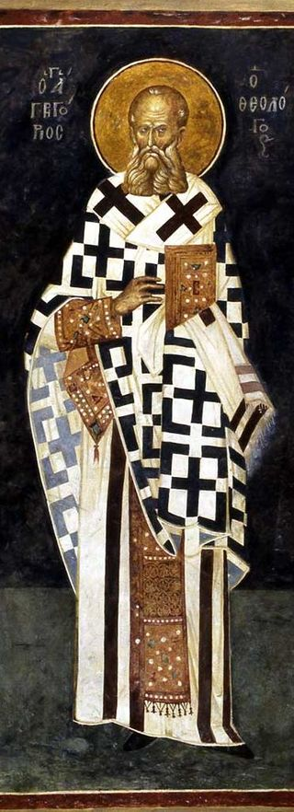
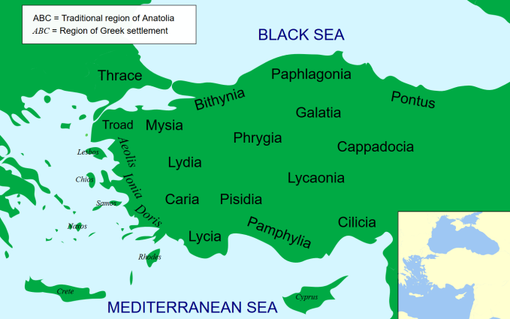
Cappadocian Fathers
St. Basil the Great (330-379)
Gregory of Nyssa (332-395) (brother of St. basil)
Gregory of Nazianzus (329-389)
St. Basil was an ally of St Athanasius
Continued the defense of the Faith
Highly educated is secular world and Theology

Slide 16
Apollinaris of Laodicea
Apollinaris was anti-Arian. He believed that Jesus Christ was the Son of God and of one essence with the Father.
He believed that Jesus Christ was God and Man*
He thought that it is not right for Jesus Christ to have a mind like ours that can sin, desire, ….
The spirit was the source of Sin, God as Holy Should not be united with such a thing.
The spirit of man is what makes him an individual. The incarnate Logos was one. Which means He did not have a spirit.

Slide 17
What is the problem?
Man as (body, soul, spirit) was created on the image of God. Man was originally good.
Man as a whole sinned.
All of Man must be redeemed.
Christ assumed human nature in order to redeem it.
“What was not assumed was not saved”
The temptation on the mountain included all three parts of Man and Christ was victorious in all three of them.
Christ took humanity and made it His

Slide 18
Who is Christ
One nature out of two natures:
Fully God
Fully Man
Christ’s humanity will be further attacked by Eutychus and the relationship between His divinity and His Humanity

Slide 19
The Holy Spirit
Another group rejected that the Holy Spirit was God (Pneumatomachians: those who resist the spirit)
They claimed that the Holy Spirit was just a creature or a special angel (above all angels) but that He is not God.
Implications:
Who dwells in us?
Who makes God known to us?
Who works in the sacraments?

Slide 20
The Bible says
The Spirit testifies to the Son (1 Jn 5:6)
Is called the "Spirit of Christ" (Rom 8:9;15:5; Phil 1:19; 1 Pet 1:1)
"Spirit of [the] Son" (Gal 4:6).
The Spirit of God (Eze 11:24) (1 Co 3:16)
The Son, i.e. Jesus, also says He will "pray to the Father, and He will give you another comforter to be with you forever, the Spirit of truth (John 14:16)
God is Truth
Sprit of Truth is the Spirit of God
God is one and is not divided. His Spirit is not sparate from Him.

Slide 21
More on the Holy Spirit
If the Spirit of the Son is created than the Son is also created
If the Spirit is an angel, are we baptized in the name of an angel? (Math 28:19)
The Spirit sanctifies but is not sanctified
Creatures are from nothing, the Spirit is from God
Creatures receive life, but the Spirit gives life
Creatures are anointed and sealed whereas the Spirit is the anointing and seal
The Father creates all things through the Word in the Spirit

Slide 22
Council of Constantinople (381)
Date: 381 AD
Emperor Theodosius
President: St. Timothy of Alexandria, Gregory of Nazianzus
Attendees: 150 Bishops
Outcome:
Confirmed the council of Nicaea
Added
“Yes, we believe in the Holy Spirit, the Lord, the Life-Giver, Who proceeds from the Father, Who, with the Father and the Son, is worshipped and glorified, Who spoke in the prophets”
Excommunicated Apollinaris and his followers (story not over)

Slide 23
Is it over?
Until today some groups claim the Holy Spirit is not God.
The problem of Apollinarious will cast its shadows on the next council
Devil continues to propagate the same heresies
We need to learn from the past to defend the faith today.

