Slide 1
Councils and Heresies
An overview of the problem

Slide 2
Why Does God allow heresies?
As we are learning more about God, He reveals to us more of Himself.
Also, the devil wants us to stray away from knowing who is the true God.
God still uses these Heresies to strengthen the faith and make more aware of who He is.

Slide 3
Progress of knowing God
In the Old Testament:
The Father was known. God was known as ONE, though many indications of the trinity
When Christ came
He declared the second person of the Trinity. To explain to us His work in creation and salvation.
When the Church started to grow
the Holy Spirit declared Himself to us.

Slide 4
Historical background
Jews
(Monotheistic)
Pagan
(Polytheistic)
Early Christians (Monotheistic and Trinity)

Slide 5
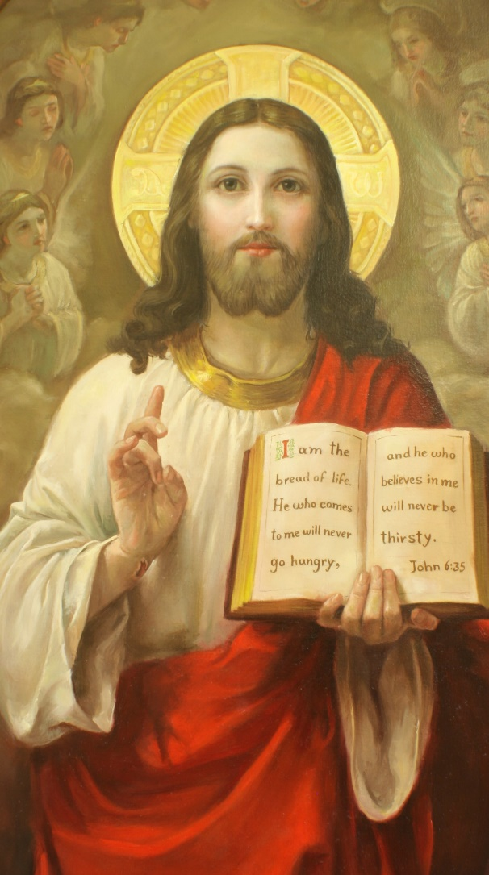
Who do you say I am?

Slide 6
Christians assertion
Jesus Christ is God
Through Him we are reconciled with the Father

Slide 7
Dilemma
How can Christ be God and there is only One God?
If Jesus is God is He also Man?
How can the Holy Spirit be God and there is only One God?

Slide 8
How to solve it?
Trust in the LORD with all your heart, and do not lean on your own understanding.
(Pro 3:5 ESV)

Slide 9
Two questions
What does it mean that Jesus is God in relation to the Father?
Who is Jesus Christ? God, Man,…? And what is the relation between His divinity and humanity?

Slide 10
How did people try to understand the relationship between Christ and God
There is only one God, His name is Father in the Old Testament, Son in the New Testament and Holy Spirit in the time of the Apostles (Sabellius)
There is only one God, His name is Father.
The Son and the Holy Spirit are some of His attributes (Monarchians)
There are 2 Gods, God of the Old Testament and the God of the New Testament (Marcion)

Slide 11
More Heresies (subordination)
God cannot create matter because He is too exalted, so he created Aeon, which created an Aeon,…. (12 different pairs of Aeons)
Until Logos is created (Gnostic)
The Son is eternal, he is a mediator between the Father and the spiritual creations.
He is less than the Father (Origen)
The Son is created by God to create the World (Arius)

Slide 12
The Faith of the Church
There is only One God with One essence (Ousia)
Three different but EQUAL Hypostasis:
Father,
Son,
Holy Spirit
ὑπόστασις
hupostasis
hoop-os'-tas-is
From a compound of G5259 and G2476; a setting under (support), that is, (figuratively) concretely essence, or abstractly assurance (objectively or subjectively): - confidence, confident, person, substance.
- Individual reality or person

Slide 13
The Trinity
The Father
Is Not
Is Not
GOD
The Holy Spirit
The Son
Is Not

Slide 14
The Trinity
Three Equal Hypostasis
One Ousia: One essence, substantial existence, that which subsists.
Homoousios (Consubstatial): one (same) substance for the Father and The Son (Since it was used 1st council but also applicable to the Holy Spirit).
The Son is begotten of the Father (John 1:14): Not in a physical sense. But like a thought from a mind
The Holy Spirit proceeds from the Father (John 15:26):

Slide 15
Versus from the Bible
John 10:30 I and my Father are one.
The Jews understood the meaning and wanted to kill him (John 10:33, Joh 19:7)
Joh 14:10 Do you not believe that I am in the Father, and the Father in Me? The words that I speak to you I do not speak on My own authority; but the Father who dwells in Me does the works.
Joh 14:11 Believe me that I am in the Father, and the Father in me:

Slide 16
Father and Son
Joh 1:1 In the beginning was the Word, and the Word was with God, and the Word was God.
1Co 1:24 Christ is the power of God and the wisdom of God.
Joh 17:21 that they all may be one, as You, Father, are in Me, and I in You, that they also may be one in Us,
And a lot more in the Bible

Slide 17
Heresy about the divinity of Christ The Arian Heresy
Lasted from the time of Arius (318 AD)
Even after the Council of Nicaea, the battle continued
Until today, a lot are denying the divinity of Christ though they may acknowledge Him as an Angel, a prophet, or a wise man.

Slide 18
What was next?
After consensus that the Son is One with Father came the next question
Who is Jesus Christ?
Is He Man?
Is He God
How He can be both?
How can God the infinite be a man
Did God really dwell with Man?

Slide 19
Heresies about the Nature of Christ
Christ was a man and elevated to a savior because of his righteousness (Ebionites)
Christ humanity was a mere appearance (Docetists)
Christ was a man (body, soul)
The Logos was His Spirit (Apolinarius)
Christ was a full man (body, soul, spirit).
The Son came and joined the Man Jesus for a period of time and left him before the cross. He had two Natures (Nestour)
Christ was initially of two natures. Than after the incarnation His divinity absorbed His humanity and he became of One Nature (Eutyches)

Slide 20
Who is Christ
He is of One Incarnate Nature out of Two Natures
Fully Human
Fully Divine
Hypostatic union of the two natures
His Humanity remained unchanged
He took humanity and made it His own
His Divinity continued to exist everywhere and to run the universe

Slide 21
"Before Abraham was, I am. " (John. 8:58).
“the Son of Man has power on earth to forgive sins (Matt. 9:6).
"... to shepherd the church of God which He purchased with His own Blood." (Acts 20:28);
"And to the angel of the church in Smyrna write: 'The words of the first and the last, who died and came to life.”
(Rev 2:8)

Slide 22
None of the rulers of this age understood this; for if they had, they would not have crucified the Lord of glory. (1Co 2:8 RSVA)
Thomas answered him, "My Lord and my God!“ (Joh 20:28)
But Jesus was silent. And the high priest said to him, "I adjure you by the living God, tell us if you are the Christ, the Son of God." Jesus said to him, "You have said so. But I tell you, hereafter you will see the Son of man seated at the right hand of Power, and coming on the clouds of heaven."
(Mat 26:63-64)
And why is this granted me, that the mother of my Lord should come to me? (Luk 1:43)

Slide 23
Next weeks we start the details
Glory be to God forever Amen

